Slide 1
Doctoral Orals Qualifying Exam
Jiangmei (Ruby) Xiong
Department of Biostatistics
Vanderbilt University

Slide 2
Table of Contents
Background: What is mIF
Current and future work in mIF data pre-processing
GammaGateR
mIF data imputation

Slide 3
What is mIF?
Immunohistochemistry (IHC)
Immunofluorescence (IF)
Multiplexed IHC (mIHC)
Multiplexed IF (mIF)
1941
Time

Slide 4
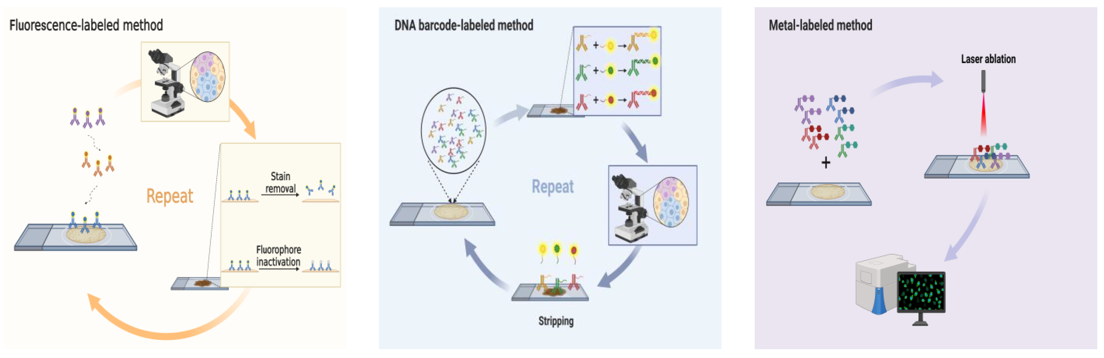
Methods for Creating mIF

Slide 5
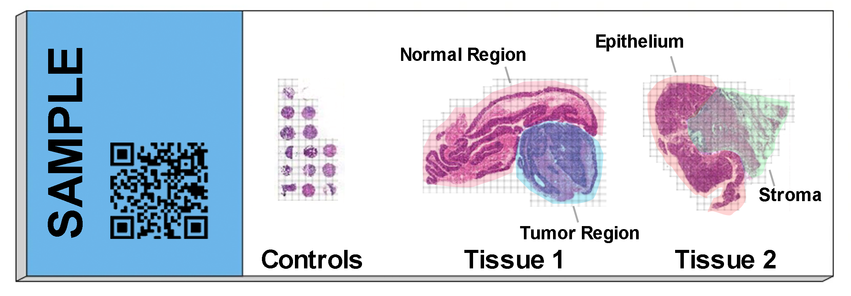
Multiplexed imaging
Multiplexed immunofluorescence is microscopic imaging that contains up to 60 channels/markers of a single tissue sample
Stained by different fluorescent materials to target particular proteins (e.g. CD4, CD8, DAPI)
Machine learning used to segment individual cells

Slide 6
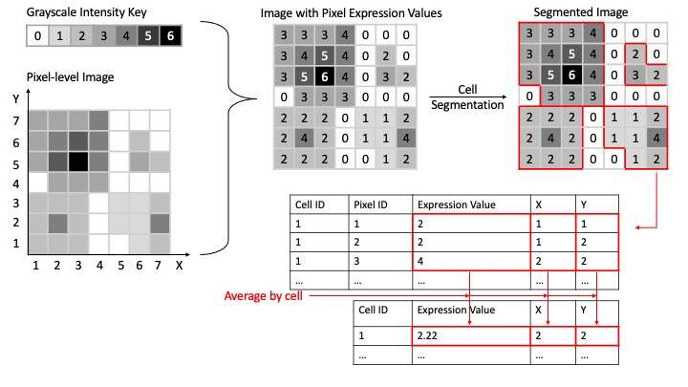
Data Structure

Slide 7
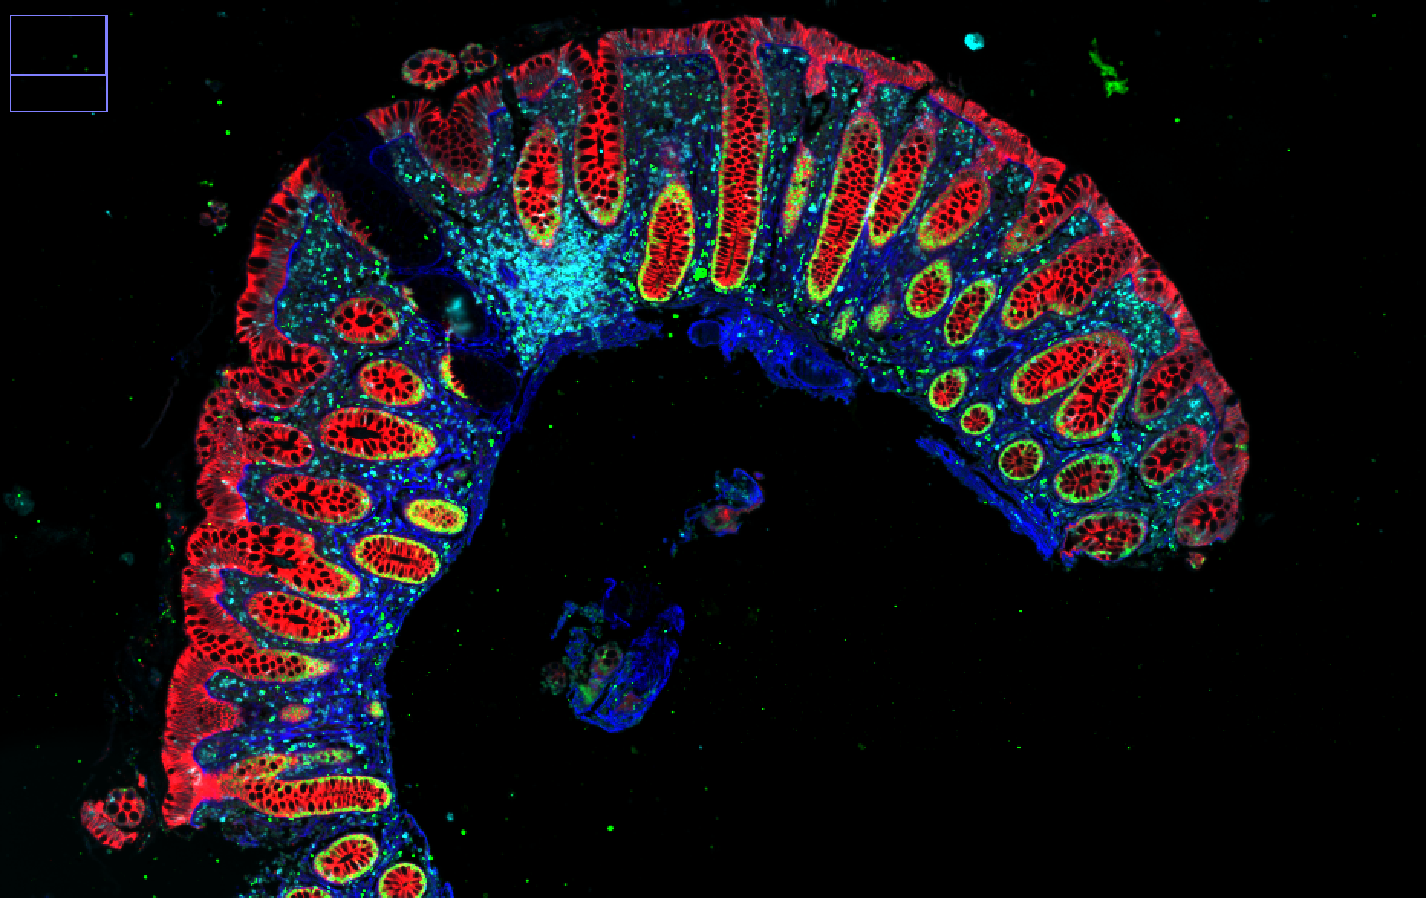
Goals of mIF analysis
Markers are used to define cell types
e.g. CD3 are generally in T-cells.
Goal of Colon MAP data is to identify spatial features associated with tumor heterogeneity.
Next Step: Cell phenotyping
critical preprocessing step for single-cell data.
Na K ATPase SOX9 Collagen CD3D
Notes:
Red is sodium potassium ATPase, green is Vimentin, Blue is CD3
CD3 identifies immune cells
Red identifies epithelium
green identifies stroma

Slide 8
Phenotype from marker

Slide 9
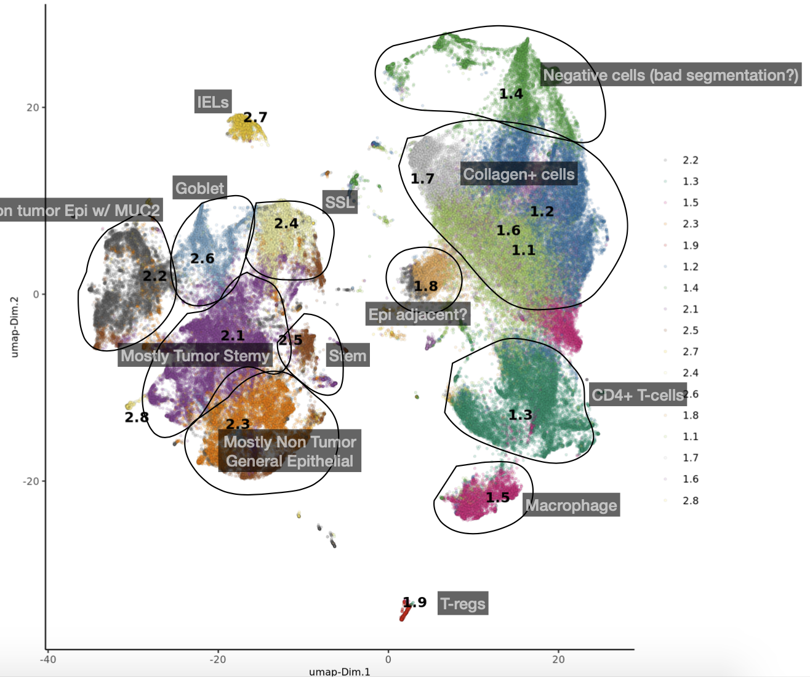
Existing methods for cell phenotyping
Methods | Pros | Cons
Unsupervised Clustering | Well developed, Easy to use | Hard to interpret, manually intensive
Manual Marker Gating | Easy to understand | Subjective, manually intensive
Supervised algorithms | Easy to implement | Hard to evaluate, Requires ground truth

Slide 10
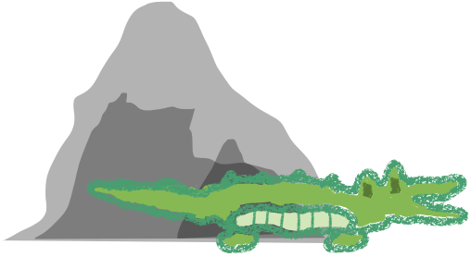
Paper 1: GammaGateR
GammaGateR
Implementation of cfGMM on mIF data

Slide 11
GammaGateR: a semiautomated approach
Gamma mixture models for mIF data:
Closed form EM estimation, parallelize across channels and slides
Constraints to incorporate biological information
Diagnostic plots for model fit, compare models under different constraints
Calculate rand index if there is a “silver standard”
Output
Mixture model parameters
Cell marker positive probabilities

Slide 12
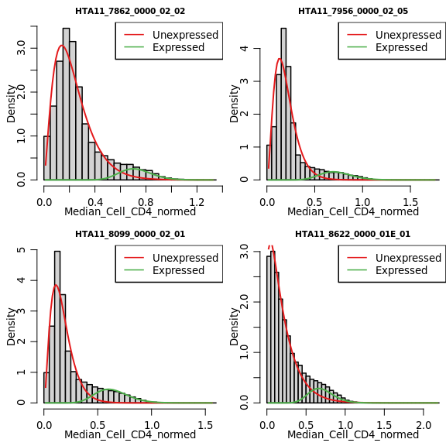
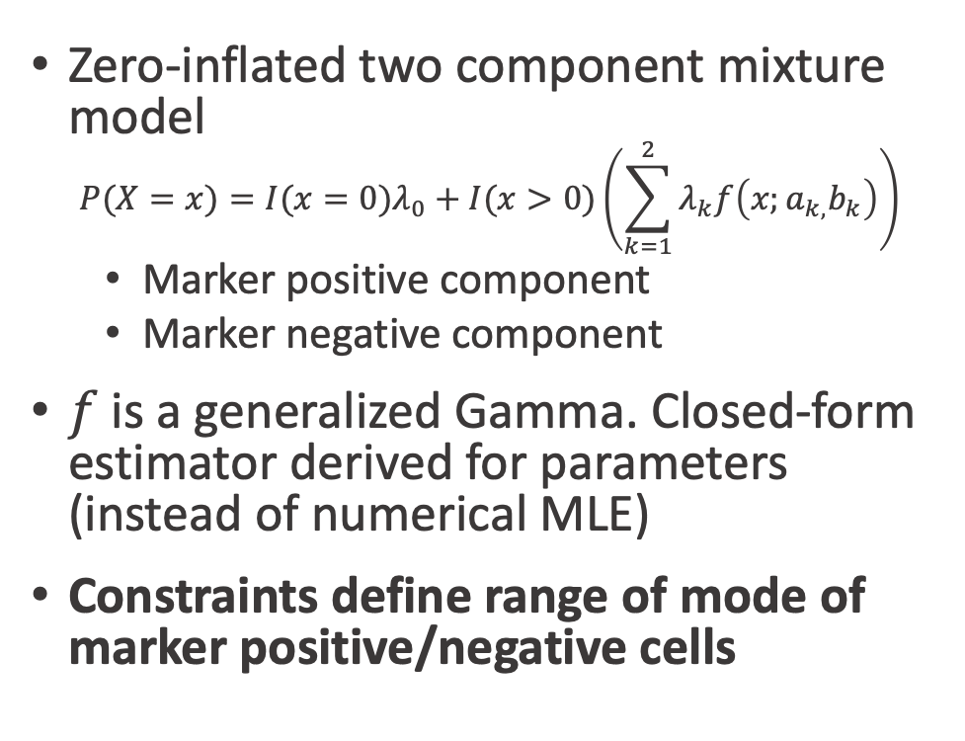
Gamma mixture model estimation
Zero-inflated two component mixture model
$$P(X=x)=I(x=0)λ_{0}+I(x>0)\left(\sum_{k=1}^{2}{λ_{k}f\left(x;a_{k,}b_{k}\right)}\right)$$
Marker positive component
Marker negative component
$f$ is a generalized Gamma. Closed-form estimator derived for parameters (instead of numerical MLE)
Constraints define range of mode of marker positive/negative cells

Slide 13
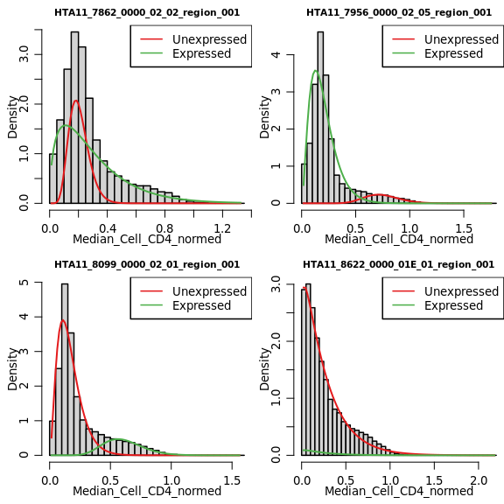
Comparison of mixtools and cfGMM in CD4
mixtools (unconstrained)
cfGMM (constrained)

Slide 14
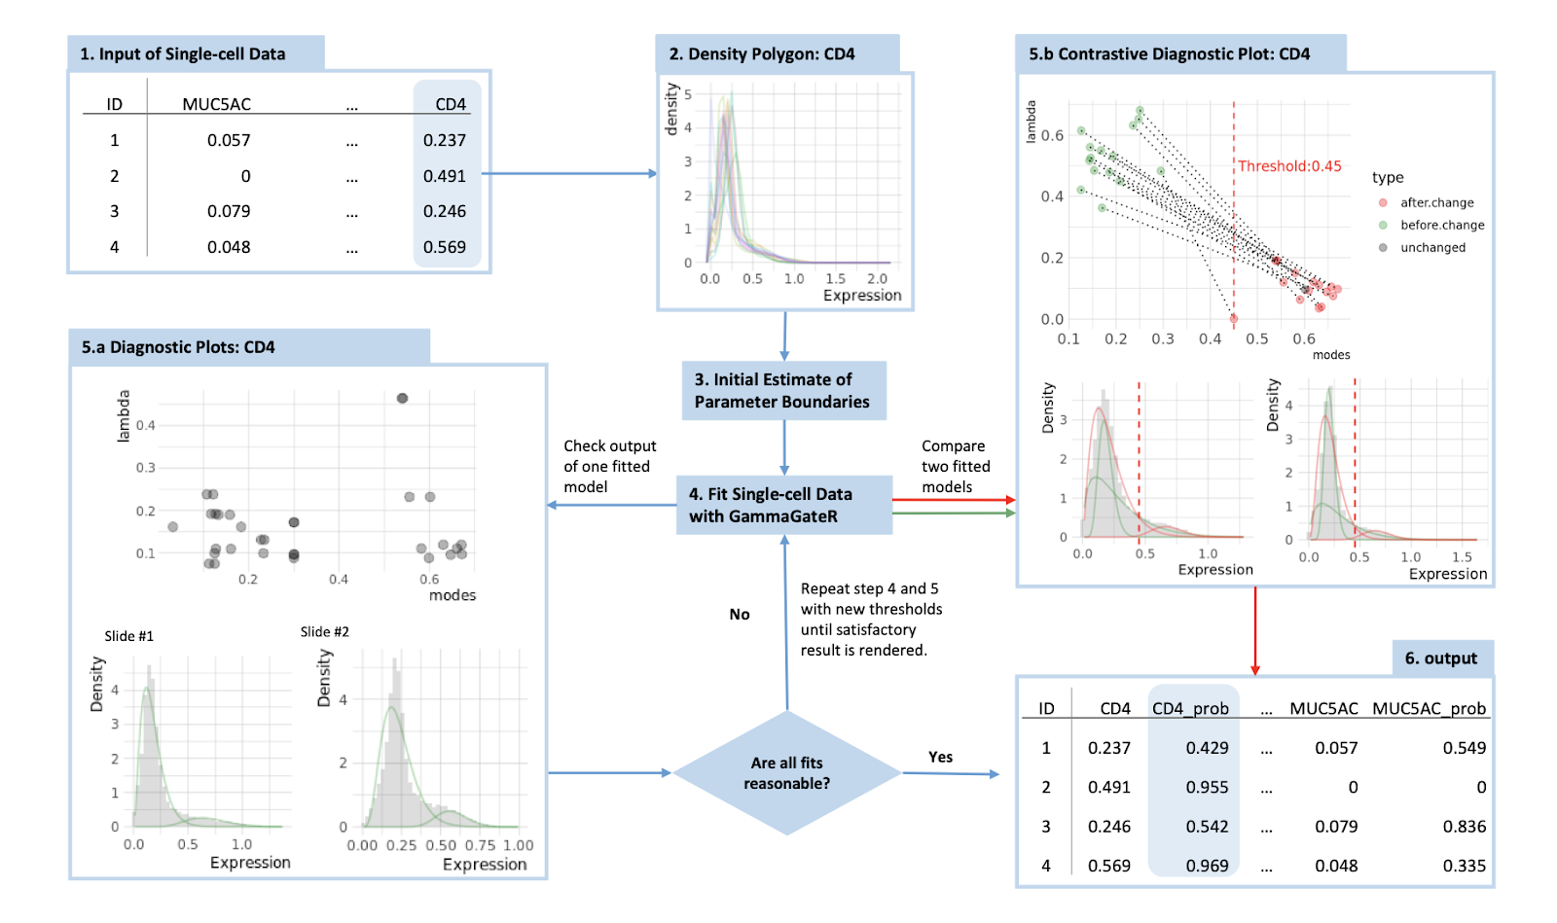

Slide 15
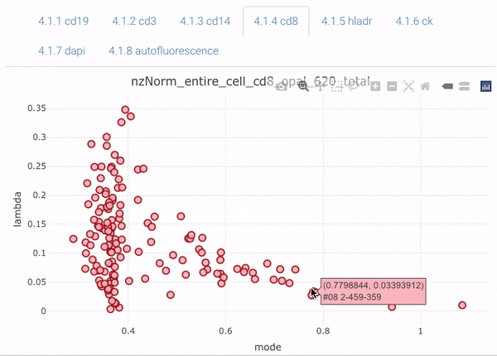
Diagnostic Plot: Interactive Scatter Plot

Slide 16
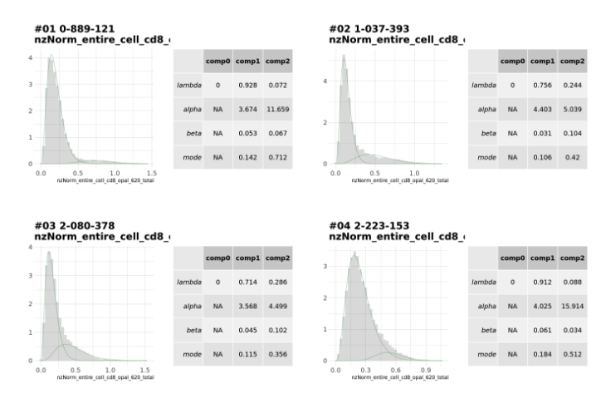
Diagnostic Plot: Individual Slide Histograms

Slide 17
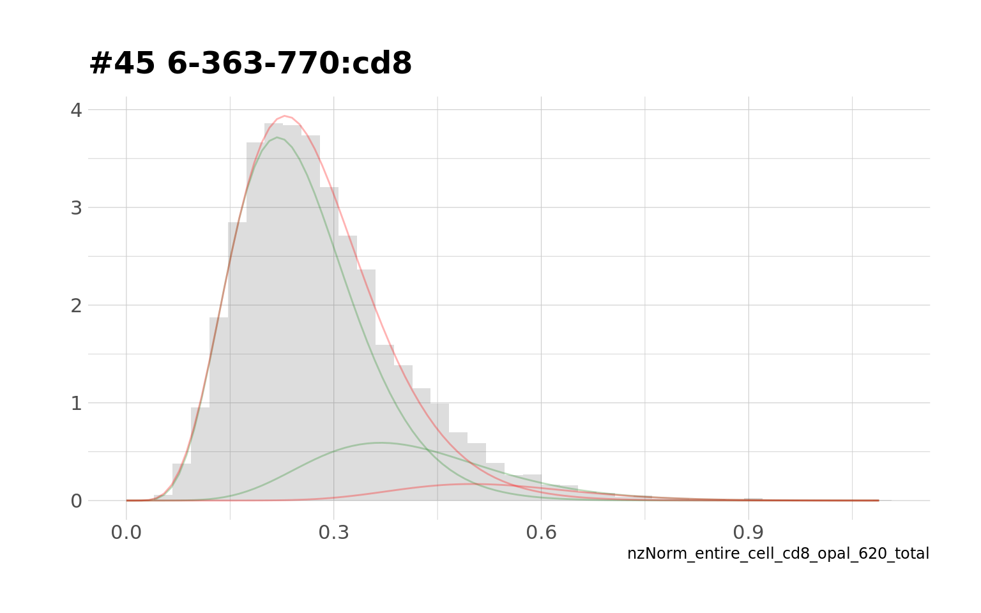
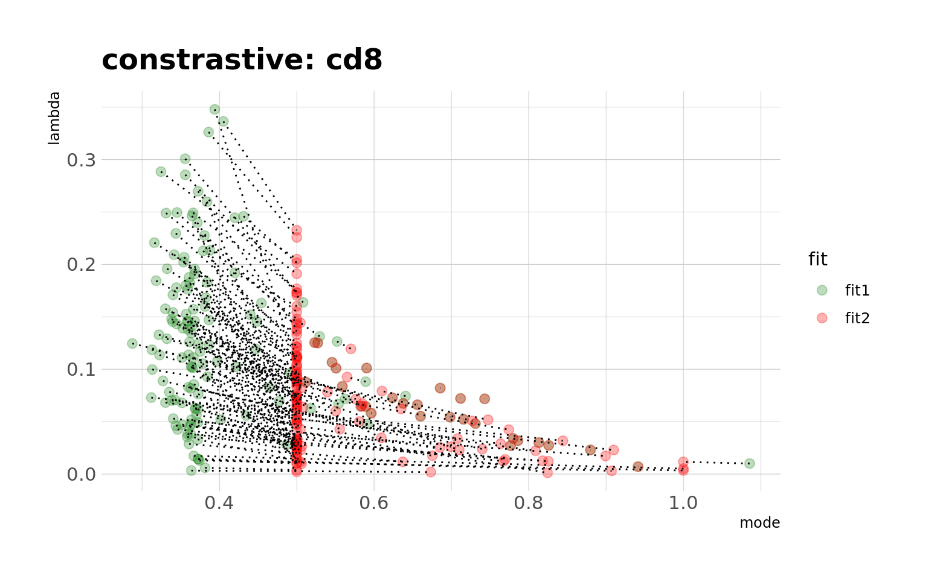
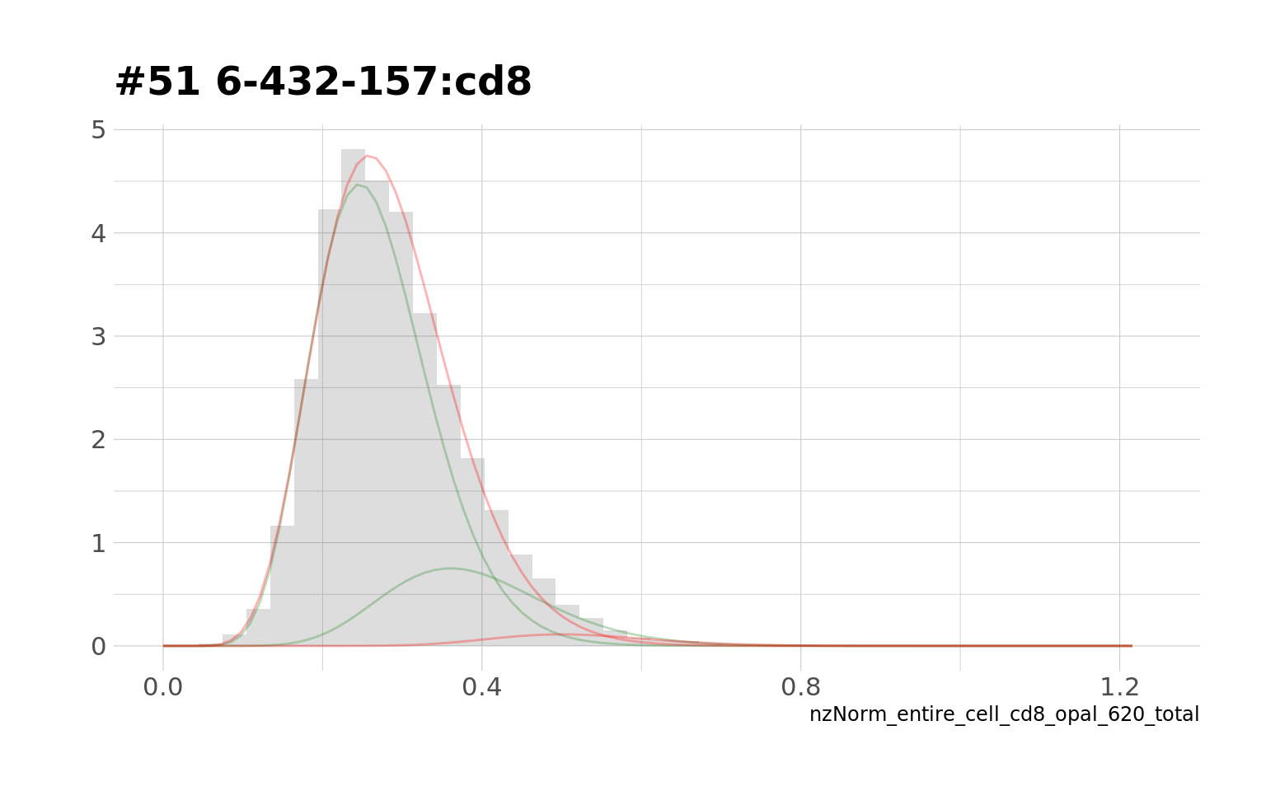
Compare model with different constraints

Slide 18
Evaluation and analysis in Colon MAP data

Slide 19
Colon MAP Overview
Goal: Identify spatial features associated with differences between adenoma and SSL
SSL – better prognostic outcome; “immune hot”
Adenoma – worse prognostic outcome; “immune cold”
Sample characteristics:
Slides: 42
Patients: 125
Cells: 2,244,117
Marker channels: 33

Slide 20
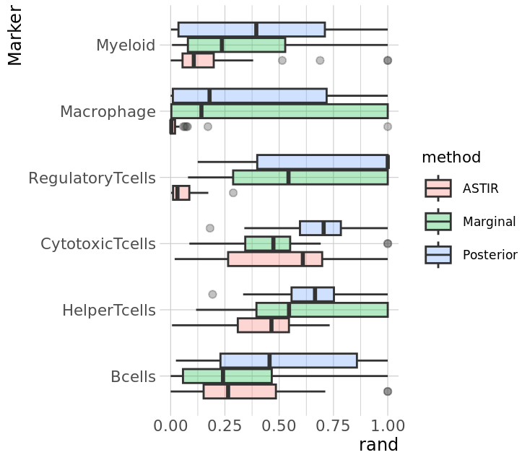
GammaGateR accuracy in phenotyping
Adjusted Rand Index with silver-standard manual label
Marginal/Posterior from GammaGateR
ASTIR is recently developed unsupervised method

Slide 21
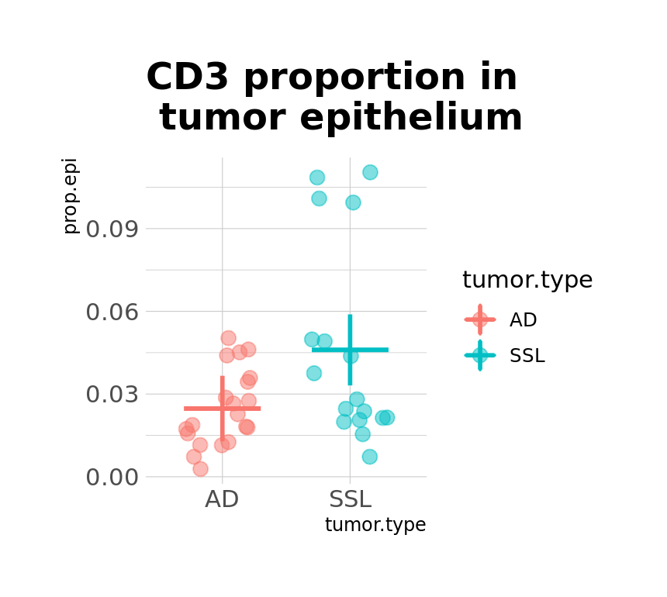
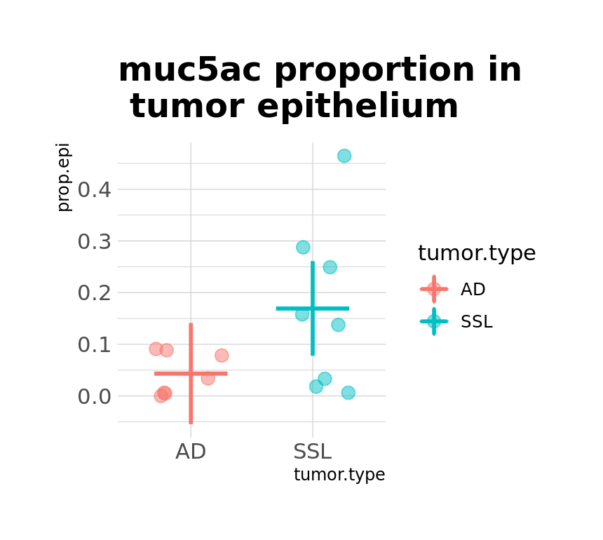
Differences in tumor microenvironment between adenoma and SSL
Cell proportions estimated from marker posterior probabilities
SSLs are associated with enriched immune cell populations (CD3+ cell proportions) in tumor tissue
SSLs have higher proportion of MUC5AC+ cells in the tumor region (not significant)

Slide 22
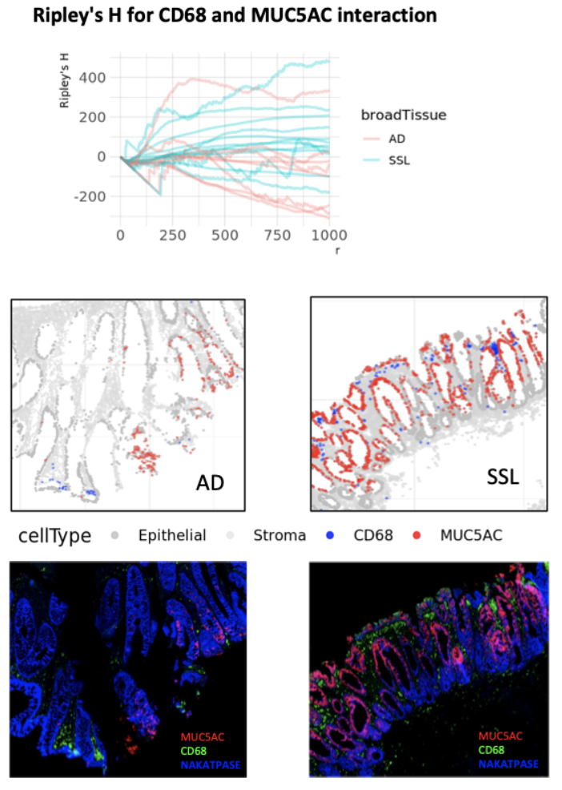
CD68+ Macrophage crowd SSL tumor cells

Slide 23
Review: mIF Image Imputation

Slide 24
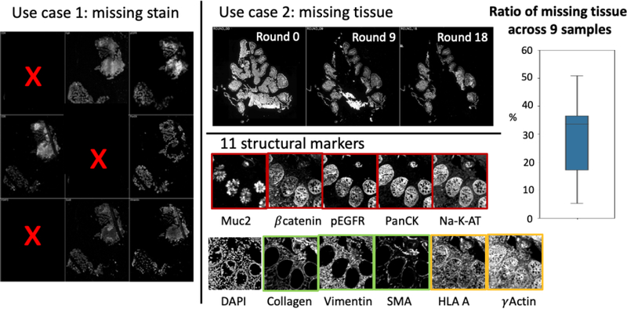
Types of Missing data

Slide 25
1. Missing Stains: pixN2N-HD
Based on Generative Adversarial Networks (GANs)
Reduces computational time compared to the “standard” methods

Slide 26
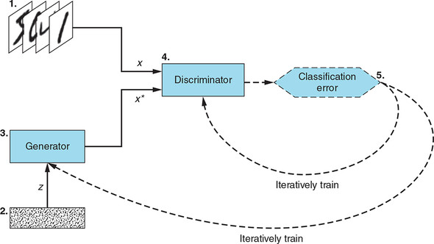
What are GANs?
Notes:
D(x) represents the probability that came from the data rather than p(g).We train D to maximize the probability of assigning the correct label to both training examples and samples from G. We simultaneously train G to minimize log(1−D(G(z)))

Slide 27
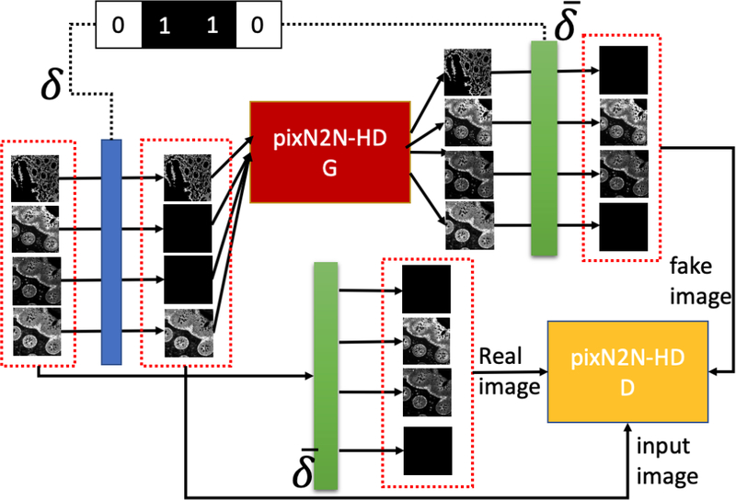
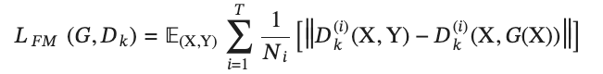
pixN2N-HD
Notes:
Feature-matching Loss

Slide 28
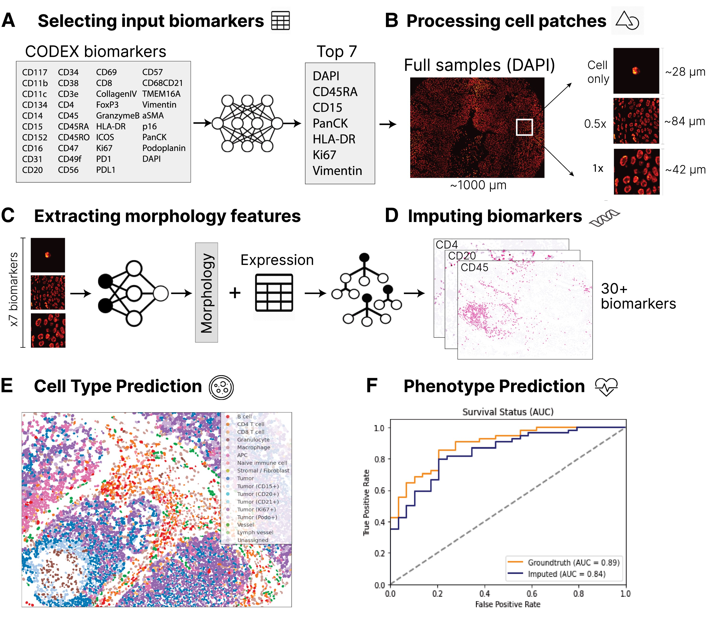
2.1 Channel Imputation: 7-UP
Main Steps:
Marker panel selection
Concrete autoencoder: feature selection method
Morphology feature extraction
convolutional neural network
Marker expression imputation.
XGBoost, a scalable gradient-boosting tree software
Evaluation: Compare with ground truth
Biomarker: pearson correlation
F1-score (2/(1/sensitivity+1/precision)
Notes:
Marker panel selection. This part will select the seven markers to start with, using concrete autoencoder. Concrete autoencoder is an feature selection method, of which the loss function is the difference between the original sample and the reconstructed low-dimension sample (Balın, Abid, and Zou 2019).
Morphology feature extraction. This step uses a convolutional neural network to learn the morphology features, i.e. spatial and structural features of cells. Convolutional neural networks are similar to layers of linear regressions, where there are more combinations of weights linked to each input variable.
Marker expression imputation. Once the location and structure of cells are learned, the important task left is to impute the expression of each marker on each cell. The imputation is performed using XGBoost, a scalable gradient-boosting tree software

Slide 29
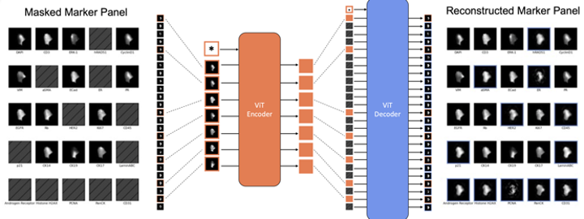
2.2 Channel Imputation: CyCIF Panel Reduction
Iteratively build up panel; select by comparing spearman correlation with training data

Slide 30
Potential Future Directions

Slide 31
Issues with existing methods
mIF channel imputation: “missing” not at random
7-UP (ignored by other methods as well): underestimated variance with imputed parameters by single imputation
Bias caused by ignoring prognostic values
Expand the scope: these issues are not uncommon in other image imputation applications, such as spatial transcriptomics

Slide 32
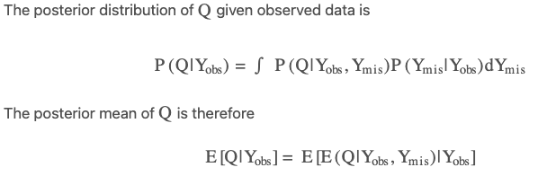
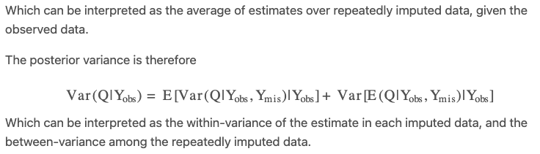

Slide 33


Thank you!
Thanks to collaborators:
Harsimran Kaur, Cody Heiser, Siyuan Ma, Eliot Mckinley, Joseph Roland, Robert Coffey, Martha Shrubsole, Ken Lau
Jiangmei (Ruby) Xiong
https://github.com/JiangmeiRubyXiong/GammaGateR

Slide 34
Future directions
GammaGateR does not explicitly account for the joint distributions of markers, which could be used for better phenotypes.
Better incorporation of batch effect could produce more accurate marker-gating.
Failed models could be imputed by combining estimates across slides, which might also help with the estimation and removal of batch effects.

Slide 35
Reference
Geuenich MJ, Hou J, Lee S, Ayub S, Jackson HW, Campbell KR. Automated assignment of cell identity from single-cell multiplexed imaging and proteomic data. Cell Syst. 2021 Dec 15;12(12):1173-1186.e5. doi: 10.1016/j.cels.2021.08.012. Epub 2021 Sep 17. PMID: 34536381.
Ye, Z.-S. and Chen, N. (2017). Closed-form estimators for the gamma distribution derived from likelihood equations. The American Statistician 71, 177-181.
Chen, B., McKinley, E. T., Simmons, A. J., Ramirez-Solano, M. A., Zhu, X., Southard-Smith, A. N., Markham, N. O., Sheng, Q., Drewes, J. L., Xu, Y., Heiser, C. N., Zhou, Y., Revetta, F., Berry, L., Zheng, W., Washington, M. K., Cai, Q., Sears, C. L., Goldenring, J. R., Franklin, J. L., Vandekar, S., Roland, J. T., Su, T., Huh, W. J., Liu, Q., Coffey, R. J., Shrubsole, M. J., and Lau, K. (2021). Human colorectal pre-cancer atlas identifies distinct molecular programs underlying two major subclasses of pre-malignant tumors. Technical report. Company: Cold Spring Harbor Laboratory Distributor: Cold Spring Harbor Laboratory
Young, D. S., Chen, X., Hewage, D. C., and Nilo-Poyanco, R. (2019). Finite mixture-of-gamma distributions: estimation, inference, and model-based clustering. Advances in Data Analysis and Classification 13, 1053-1082.

Slide 36
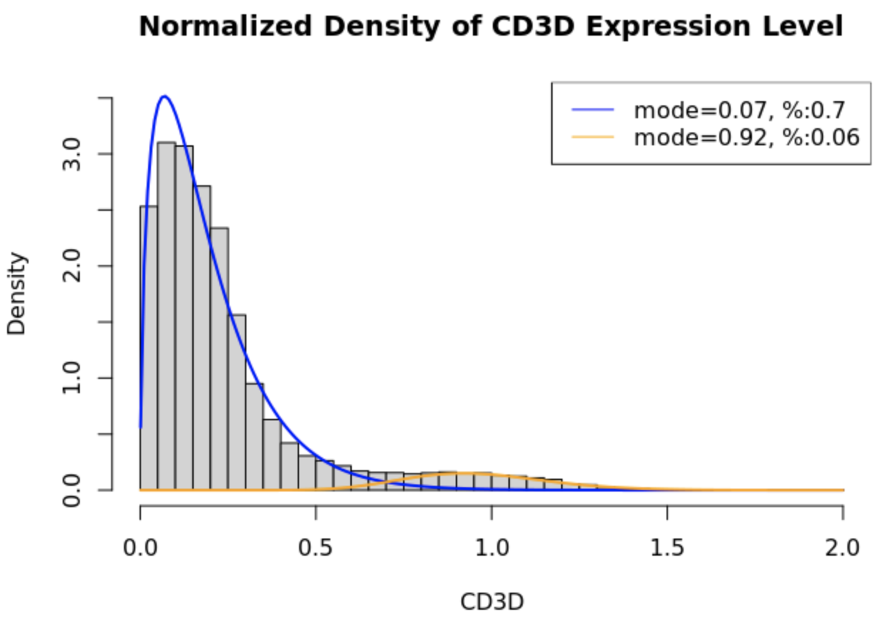
Gamma mixture models
Data are strictly positive and skewed, sometimes no mode: Gaussian models.
Gamma mixture models (GMM) flexible with skewness.
Limitation 1: Time consuming with fitting because MLE not closed-form.
Limitation 2: Variation in slides yields inconsistent fit.
We develop a cfGMM with constraints to perform consistent and reproducible marker gating.

Slide 37
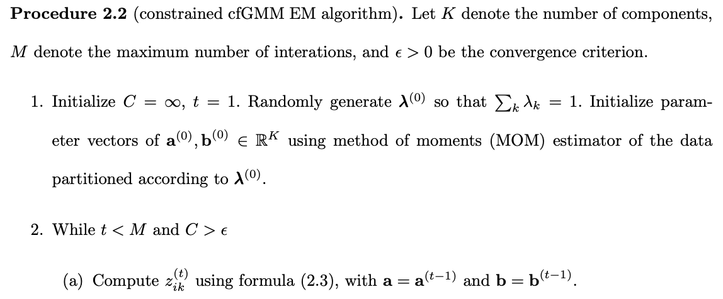
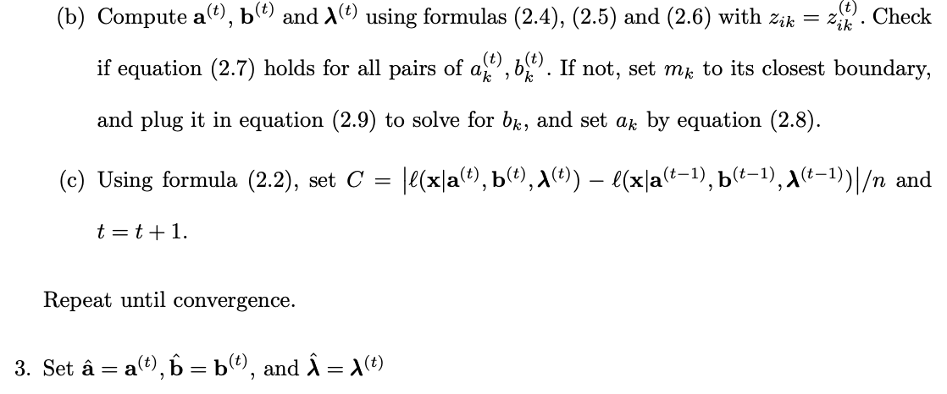
Notes:
Go faster, don’t say much.

Slide 38
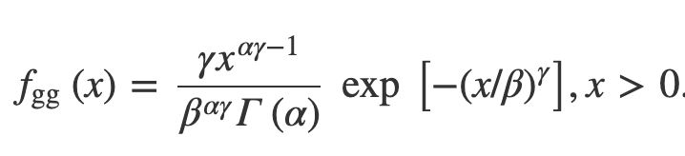

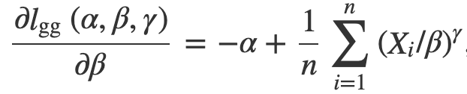
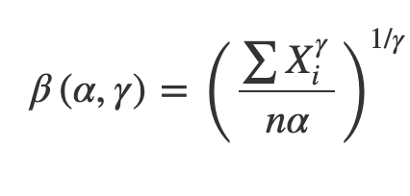
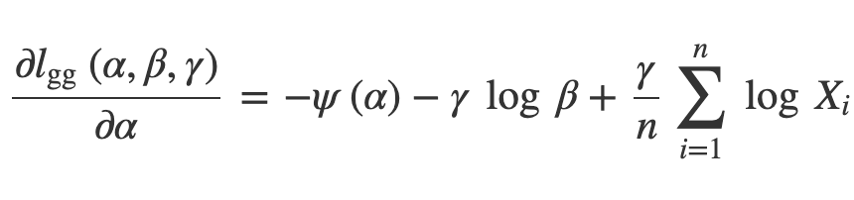
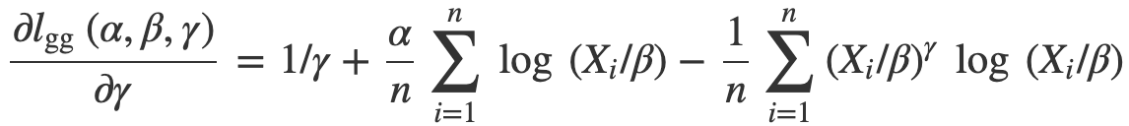
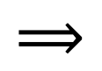
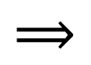
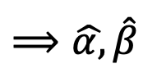
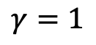
The trick to closed-form gamma estimator³
$$⟹$$
$$⟹$$
$$⟹\hat{α,}\hat{β}$$
$$γ=1$$

Slide 39
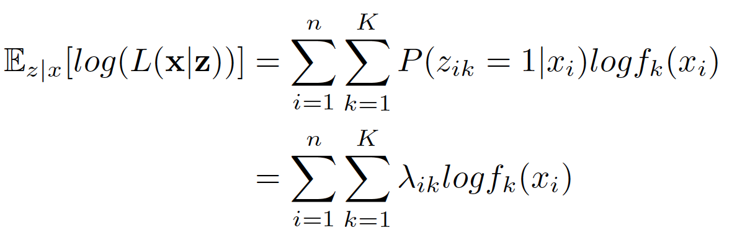
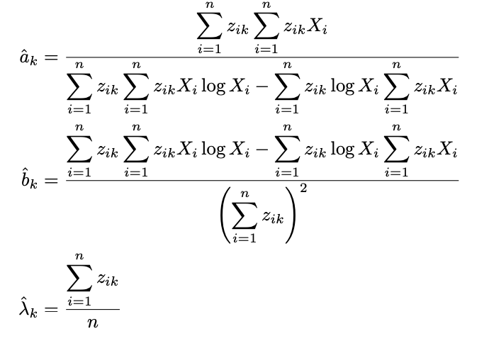
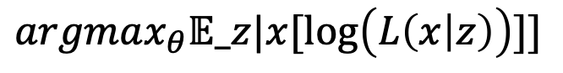
Comparing ML versus cf GMM
Expectation of complete data log-likelihood
Estimator for k-component mixture model
$$argmax_{θ}𝔼_z|x[\log\left(L\left(x | z\right)\right)]]$$
Notes:
Add a max infornt of expectation: numerical maximization is in every iteration

Slide 40
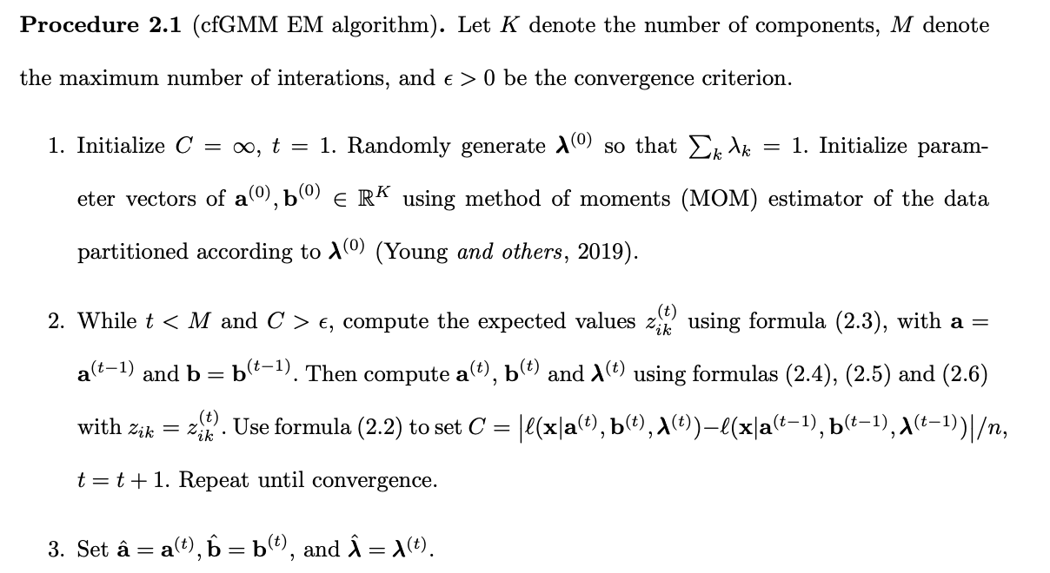

Slide 41
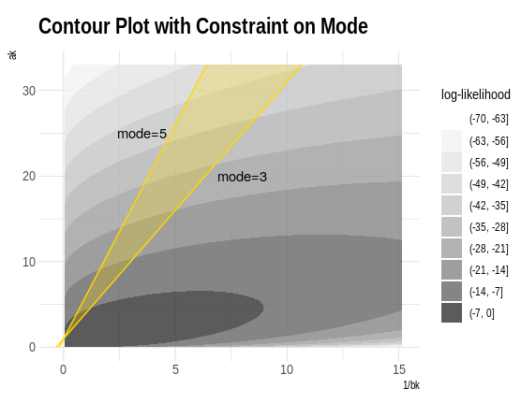
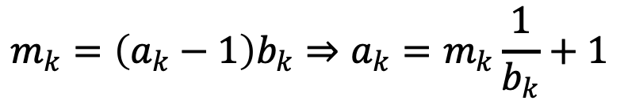
Incorporating constraints on the mode
Practical for user to specify mode constraint
If MLE out of bound, the maximum will be “caught“ on the boundary. We can plug in mode constraint to the formula.
Unfortunately, if mode is specified, the closed-form trick no longer works so we resort back to old method when imposing constraints.
$$m_{k}=\left(a_{k}−1\right)b_{k}⇒a_{k}=m_{k}\frac{1}{b_{k}}+1$$

